Slide 1

SAI VIDYA INSTITUTE OF TECHNOLOGY
Department of Computer Science and Engineering
Accredited by NBA, New Delhi
Rajanukunte, Bengaluru - 560064
Internship (18CSI85) Presentation on
Full Stack Web Development
Internal Guide
Mrs. Sreelatha P.K
Asst. Prof.
CSE
Presented By
Shubham Kumar
1VA18CS046
External Guide
Kishore V
Internship Coordinator, COO
Softora Technologies Pvt.Ltd
2021-22

Slide 2
Presentation Outline
About the Organization.
About Department.
Task Performed.
Reflection Notes.
References.
Dept. of ISE, SVIT

Slide 3
About Organization
Founded by Suraj Tiwari and a small group of highly committed entrepreneurs, Softora Technologies Pvt. Ltd. was born with a vision to ‘bring your ideas and designs to life We believe in designing, developing and delivering the products as per your need!’
It provide websites that are compatible on any device be it phone, tablet or our pc, Making sure we can access it anytime, anywhere.
Finding innovative ways to customize our website and catering to our needs, Softora will make sure we're as compatible as possible to give you a fun and an efficient experience.

Slide 4
About Organization / Company
Services:
Website Design/ Website Development
Logo Design/ Logo Making
Poster Design/ Flyer Design
Business Card Design

Slide 5
What is Full Stack Web Development
Definition: Full stack development incorporates both backend and frontend web dev
While backend development is a component of full stack development, full stack focuses on functional knowledge and isn't as specialized.
A full stack web developer is a person who can develop both client and server software.
In addition to mastering HTML and CSS, he/she also knows how to: Program a browser (like using JavaScript, jQuery, Angular, or Vue) Program a server (like using PHP, ASP, Python, or Node)

Slide 6
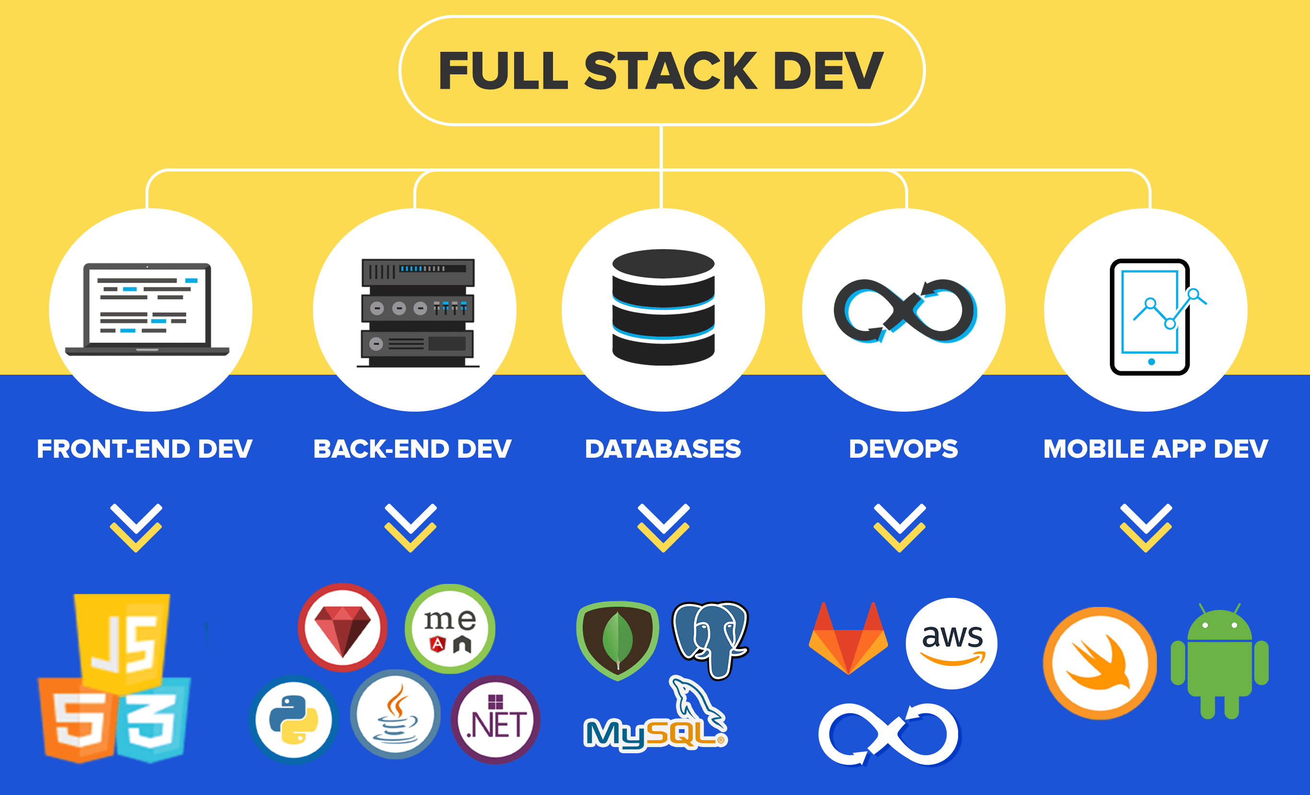
An Over View Of Full Stack Web Development

Slide 7
Problem Statement
Create a simple dynamic Full Stack Web Application which has the following specs. Design and develop a Task manager App.
It should has register/login and logout feature, user can create a new task and submit it.
User must be able to perform C.R.U.D operations.
In addition to this user must be able to mark task as complete.

Slide 8
About Department
Technical Department:
Administration
Technical support
Programming
Company website
Application development

Slide 9
Objective and Proposed System
Objective:
The main aim is to develop a responsive full fledged web application with
good interface and robust backend.
Problem Definition:
The Task Manager must be simple and responsive with options for
various functions . The application should support to save the created task to database. It must
support to delete/edit the task. It should give the option for user to logout from their account.

Slide 10
Methodology and Flow diagram:
Methodology
Complete interactive and responsive user interface using HTML, CSS and JavaScript.
Allow user to register/login and logout.
Users can create tasks.
Mark the task as completed or edit the task.
User can delete the task from the database.

Slide 11
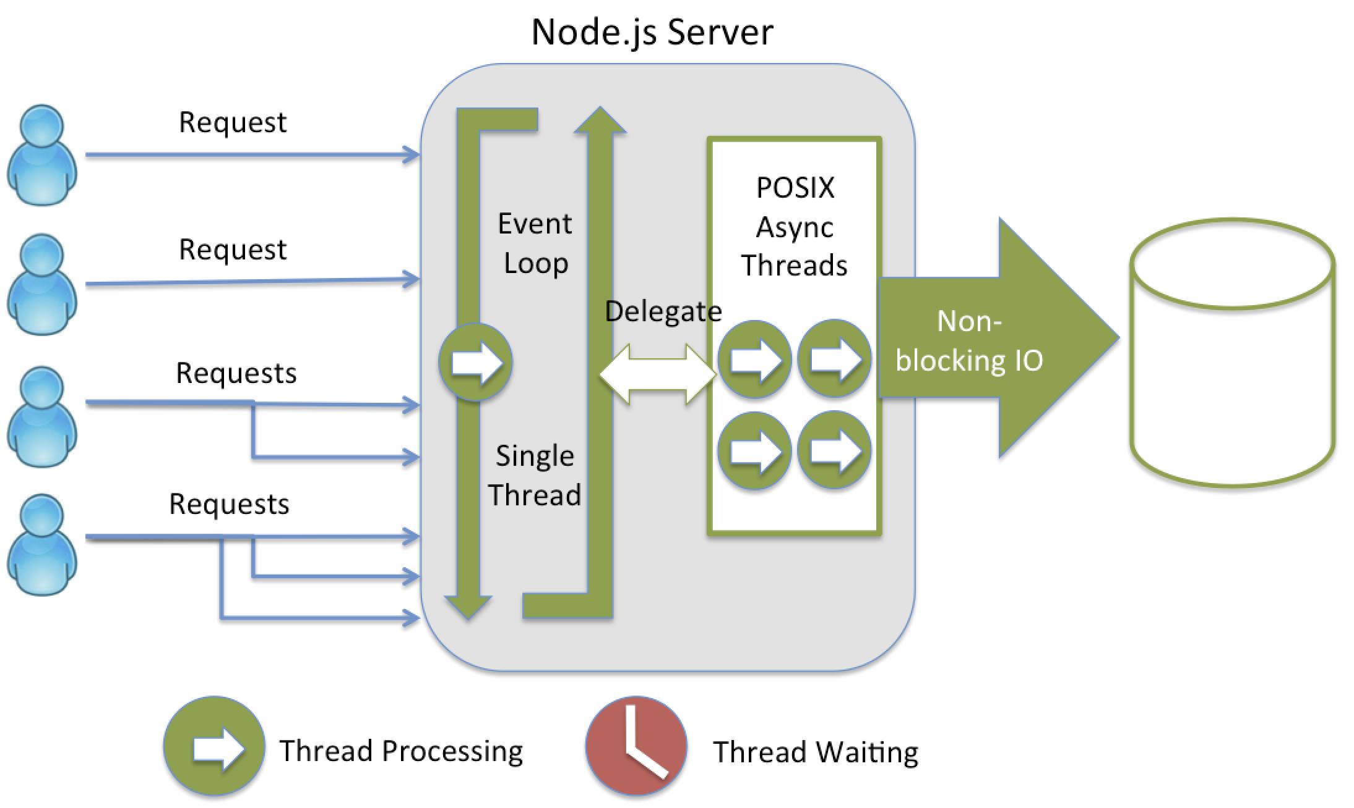
Node.js System Architecture

Slide 12
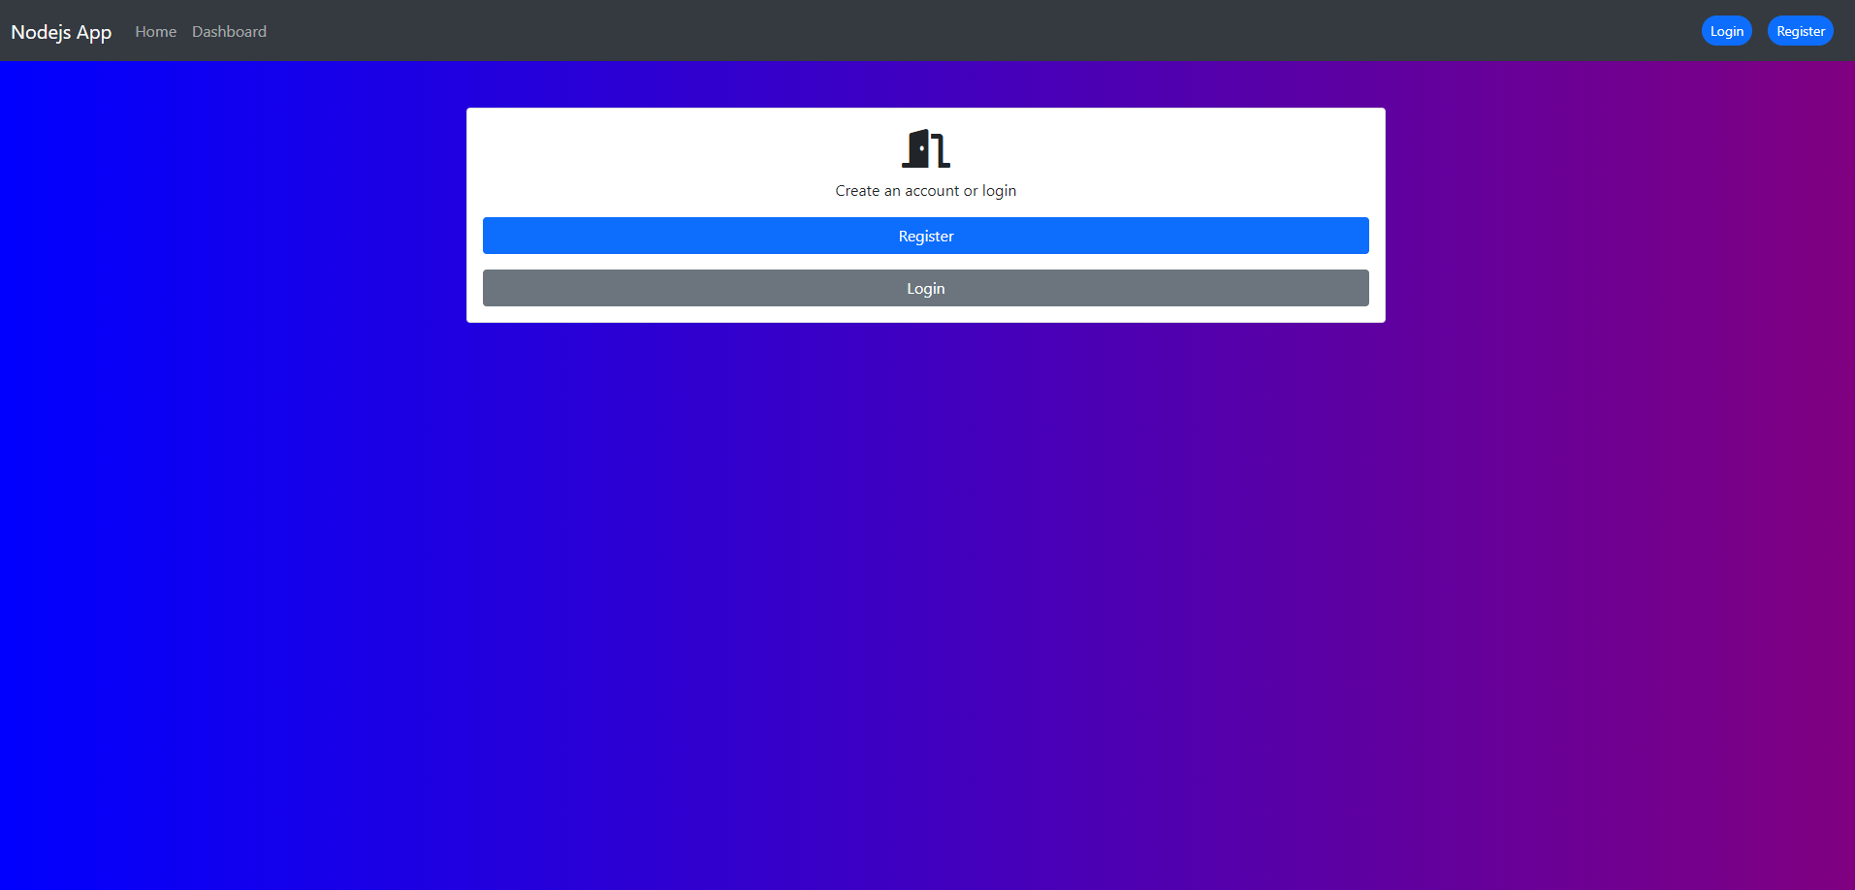
Application Interface

Slide 13
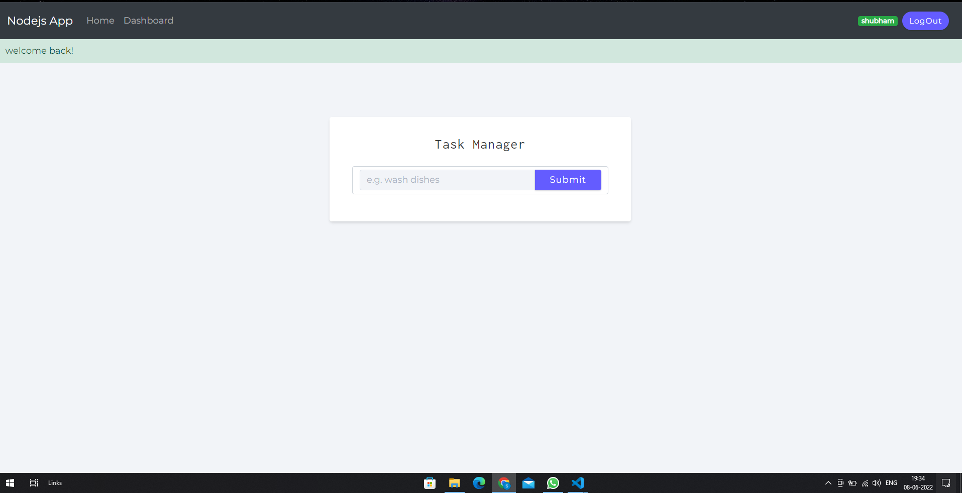
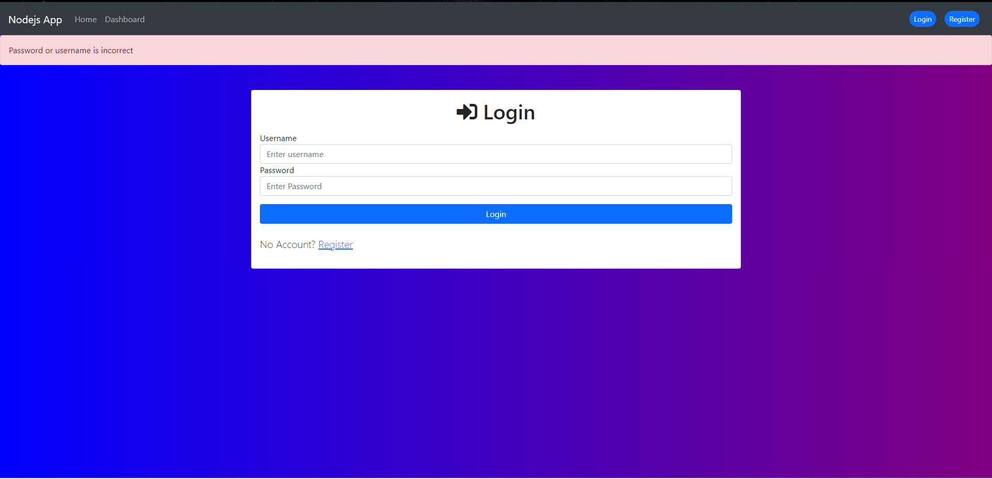
Application Interface

Slide 14
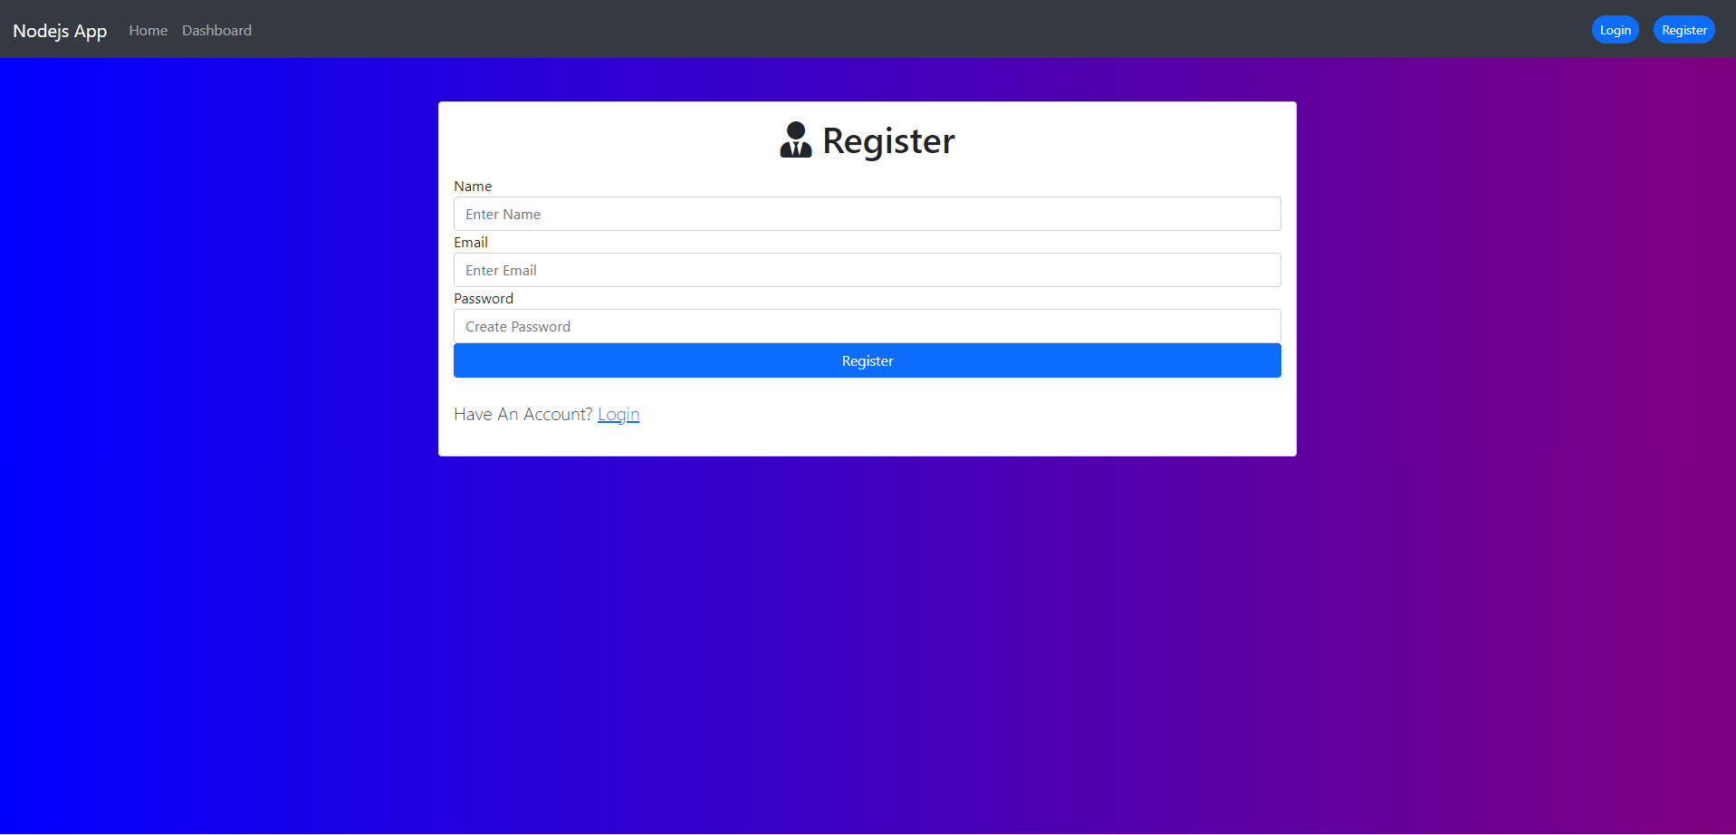
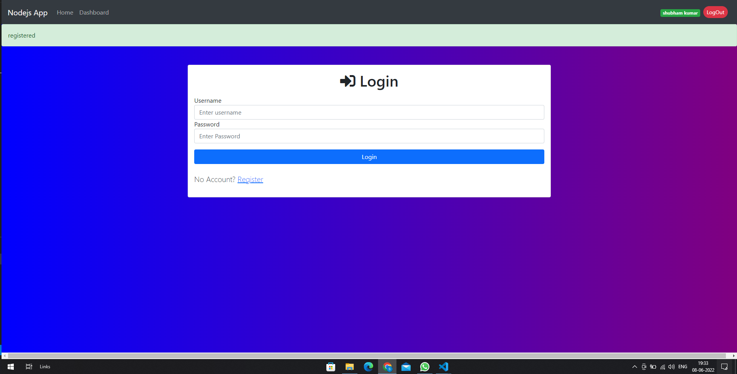
Application Interface

Slide 15
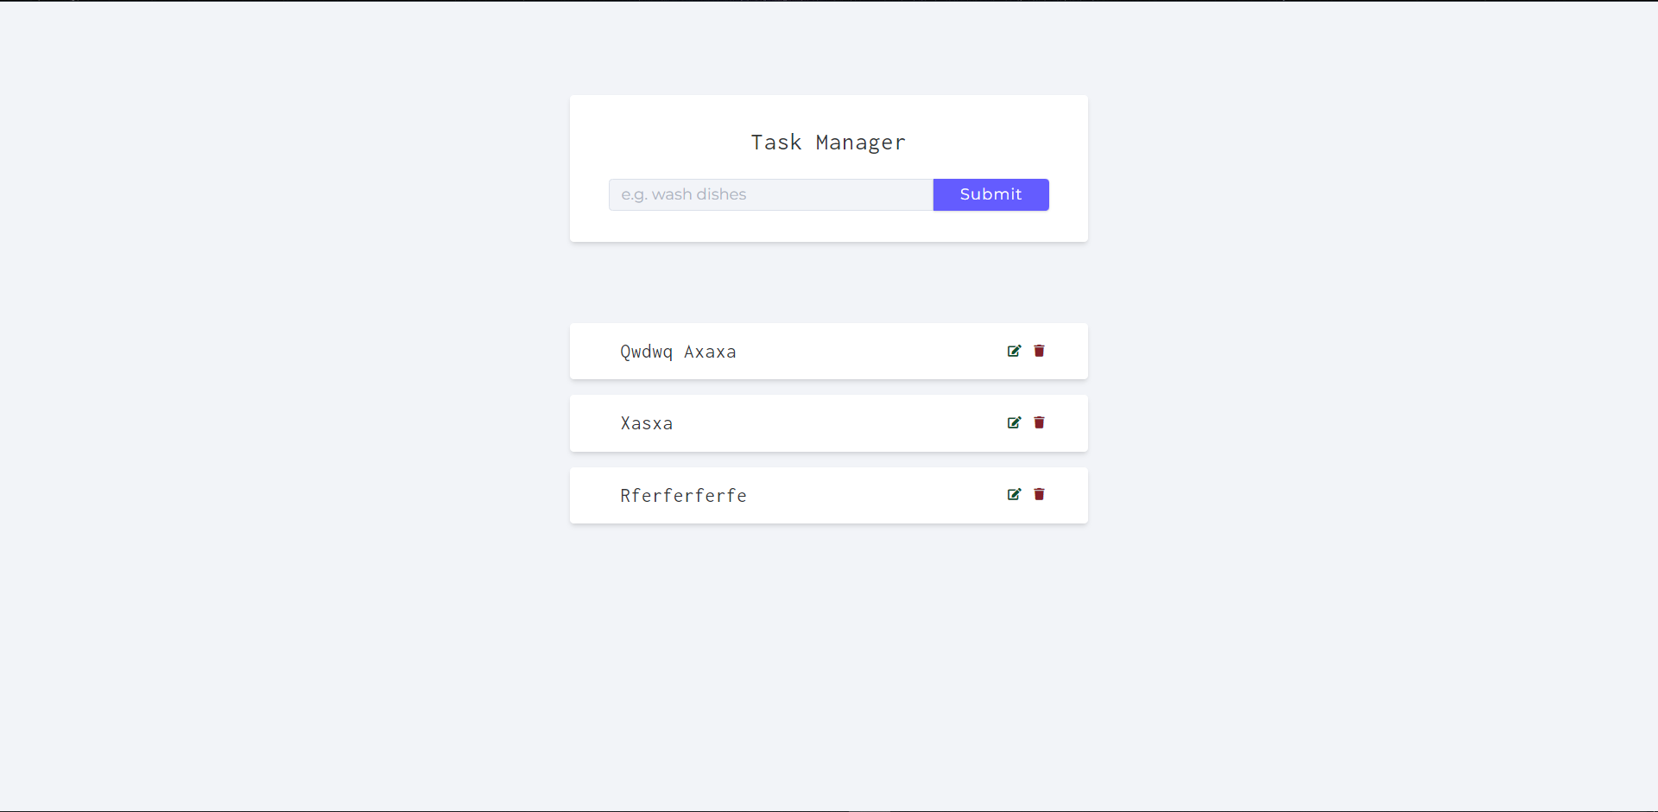
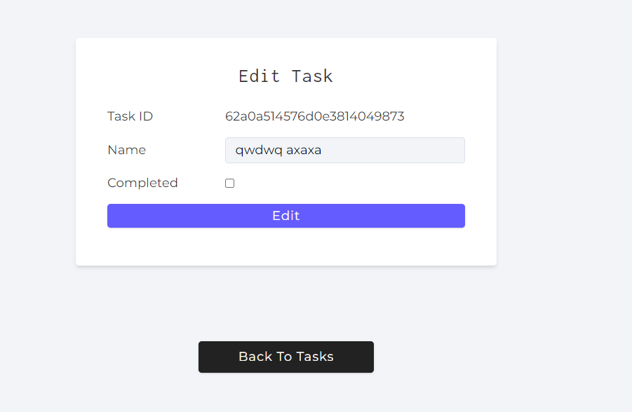
Application Interface

Slide 16
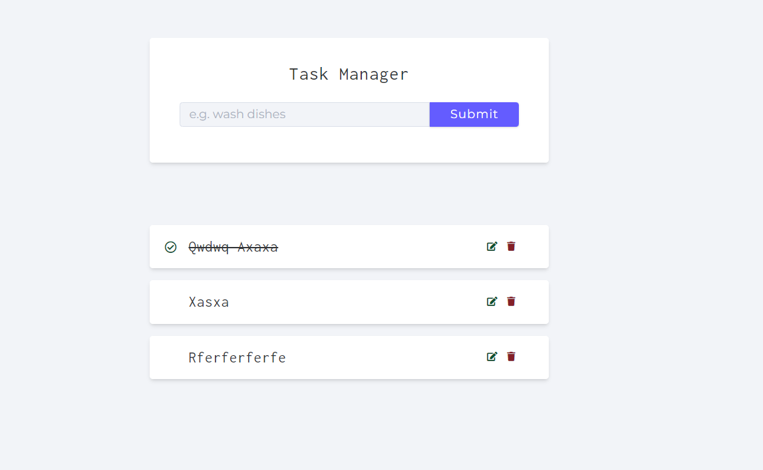
Application Interface

Slide 17
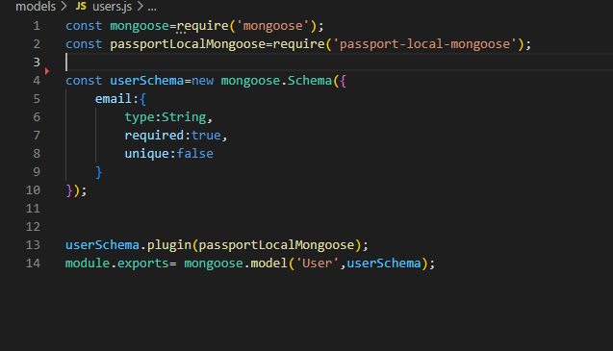
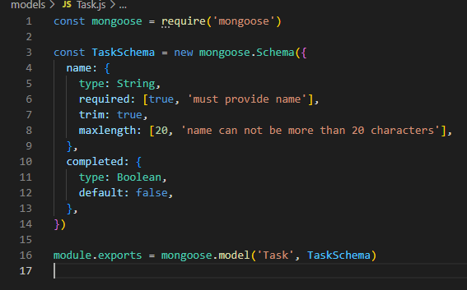
Working of the application
User Schema
Task Schema

Slide 18

Working of the application
Step:1 Make get request to /register rest api
Step:3 Make get request to /login rest api
Step:2 Make post request to /register rest api
Step:4 Make post request to /login rest api

Slide 19


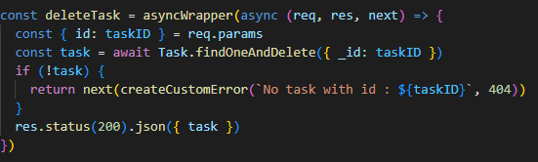
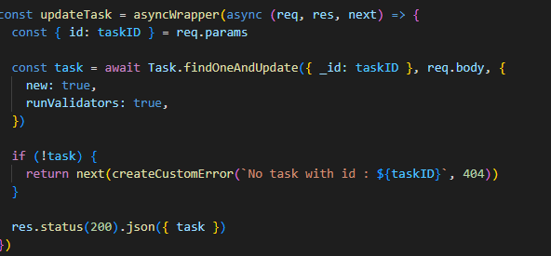
Working of the application
Create a new task
List all the tasks
Delete a particular task
Update a particular task

Slide 20
Reflection Notes
Front end technologies like HTML, CSS, JavaScript and Bootstrap.
Back-end Node.js, Express.js
Making application responsive
Using version control system i.e. GitHub
Designing restful routes
Integrating front-end with backend
Database i.e. MongoDB

Slide 21
References
https://www.udemy.com/course/the-web-developer-bootcamp/
https://www.w3schools.com/
https://developer.mozilla.org/en-US/docs/Web/JavaScript
https://getbootstrap.com/docs/5.2/getting-started/introduction/

Slide 22
Thank you

